Slide 1
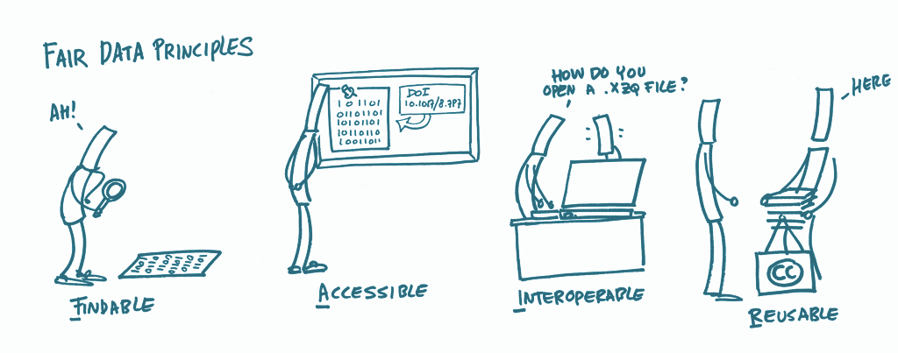
Reusability in FAIR research
Andrea Lorenzon data scientist & software engineer andrea.lorenzon@ceric-eric.eu

Slide 2
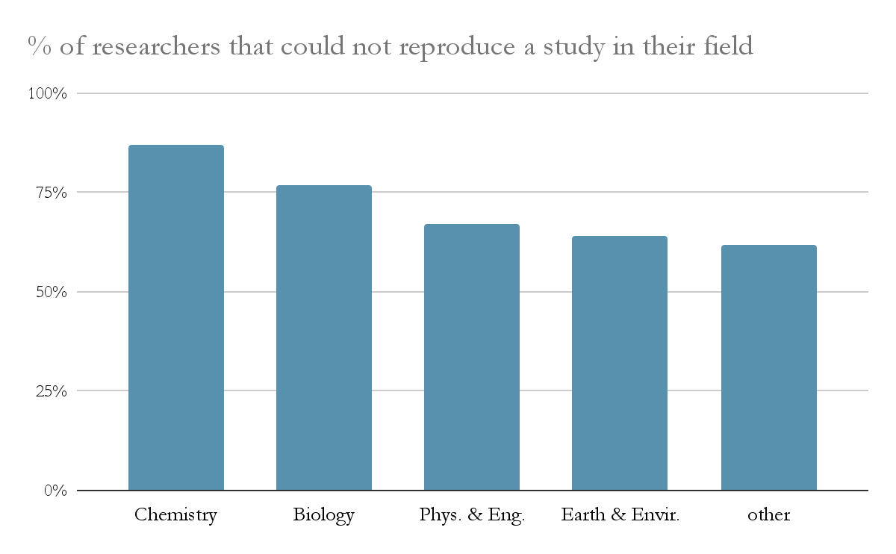
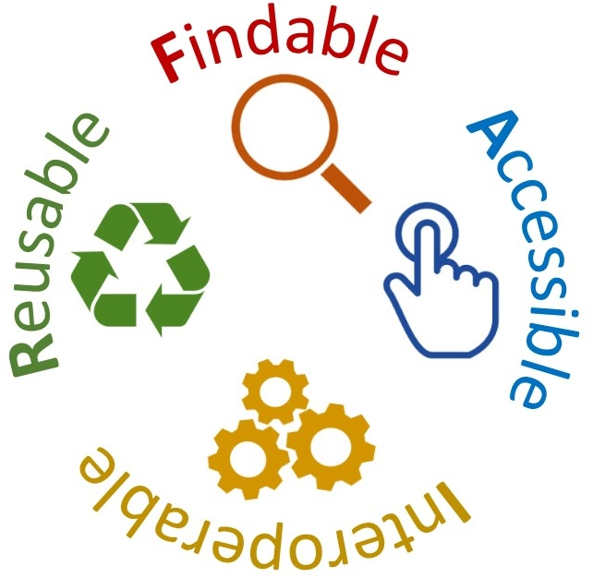
Current state of experimental reproducibility in data science
Reproducibility is a major cornerstone of science.
An increasing portion of experimental research cannot be reproduced.
A non-reproducible experiment cannot generate a valid scientific result, maybe a case report.
Lack of reproducibility brings lack of trust in conclusions and, consequently, in the scientific community itself.
Current publication system, publish-or-perish, is not currently doing enough to promote reproducibility, often seen as a loss of time and resources, but things are changing.
Playing around
Science
+ taking notes
Reproducible science

Slide 3
Pros and cons of reproducible research
Reproducible research
Non reproducible research
pros | cons
Your work matters and makes the difference | You have to work with method
More citations: one experiment, many results | Cost to embrace it (time, money)
Access to better funding and infrastructure | You have to get rid of the Old Ways
pros | cons
Faster | More likely to produce useless results
Easier | Reduces trust in science
Cheaper | Harder to access funding and infrastructures
(But maybe we can help you with these.)

Slide 4
Sources of lack of reproducibility
Reproducibility reducing factors:
Malicious causes (p-hacking, data dredging, HARKing, purposeful model overfitting)
Non-malicious causes (lack of information):
Methodology bound: information is lost
Loss of informations about samples
Loss of informations about data acquisition
Loss of informations about analysis process
Resource bound: information is not acquired
Lack of repetitions
High experimental costs
Lack of time (again: publish or perish)
Just don’t cheat!
Addressable through FAIR policies
Addressable through more funding

Slide 5
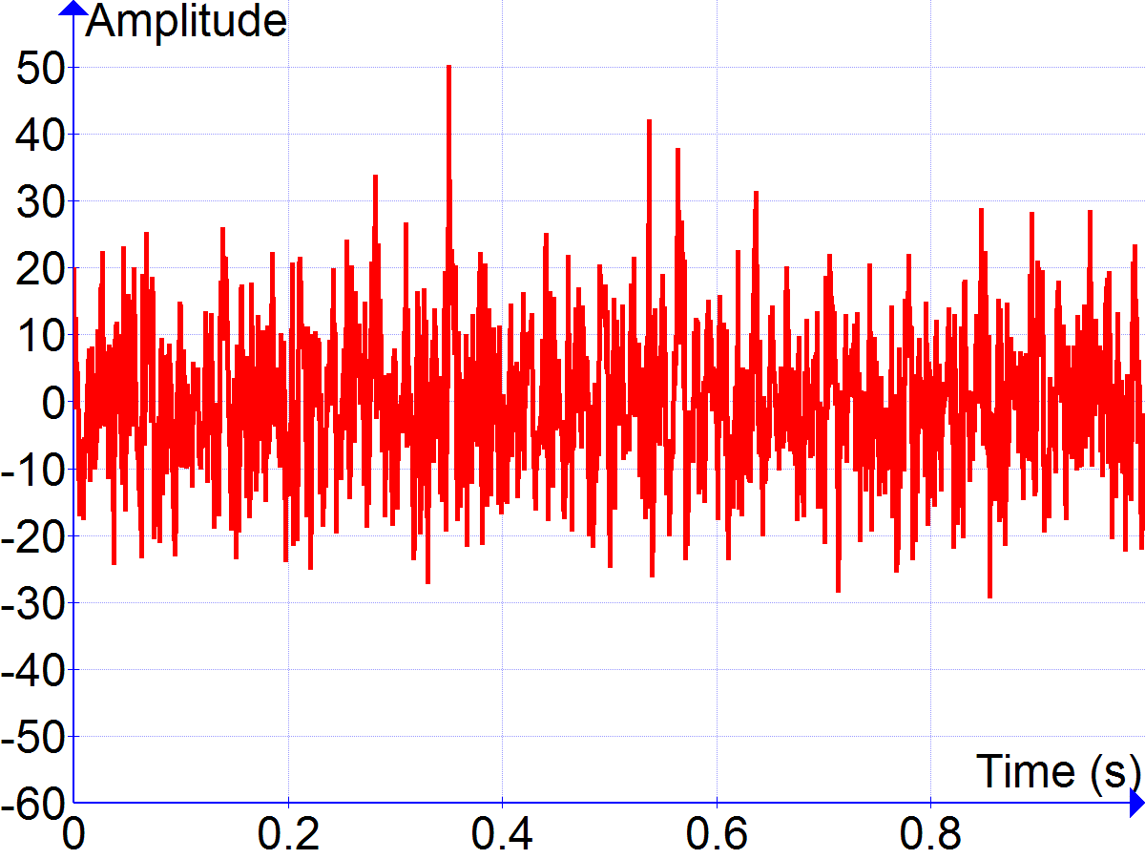
The cost of reproducible science vs the alternative
“Information” : Knowledge.
“Data”: Facts and figures.
Knowledge can be distilled from data.
So we need to manage data, to care about information.
Data Objects:
Data: collection of facts. Numbers, values, readings, matrices, pictures, plots, recordings, samples.
Metadata: collection of facts about data. Acquisition parameters, operators, experimental setup settings, tools and components, time, measure instruments, software versions, hardware description, reagents batch #, sample sources, and anything that can be used to replicate, understand and interpret data.
Procedures/infrastructure: what/where you did it. Protocols, infrastructure characteristics, instructions, quality procedures, logbooks, data analysis pipelines.
Instrument: MassSpectrometer datetime: 28.5.2021, 12.21 Sample: AnomalousSample01
Source: BlackMesa Res.Facility Y axis: Signal Amplitude
X axis: Measurement Time
Operator: Gordon Freeman
….
Before: wear HEV suit
Step 1: Put the sample on the cart
Step 2: Switch on MassSpectrometer
Step 3: Wait for MS to startup Step 4: push cart into beam warning: be careful about resonances
Step 5: get crowbar
….

Slide 6
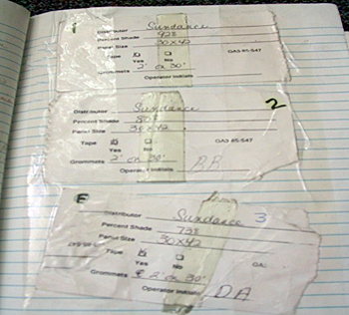




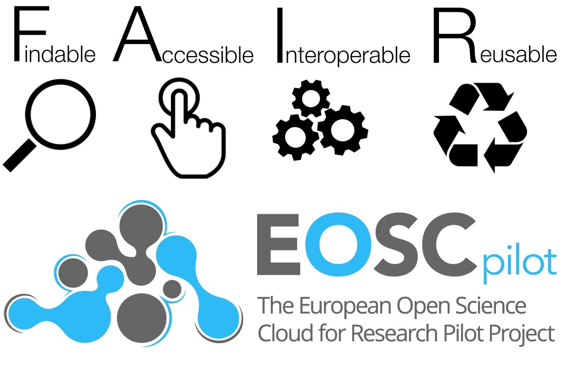
How to create a reproducible research environment?
The worst idea is to just write the most interesting results and notes on your paper laboratory logbook.
A first approach is versioning data. Git, SVN. Many platforms exists that supports backup, versions, attaching information to data. A lot of limitation persists (pipelines? Ext. software versions? dependencies? Metadata? Standardization of analytics?)
A better approach is to embrace a Data Management strategy, and use one of the available resources, like EOSC, to support you at every step of your research:
Acquisition
Storage
Analysis
Sharing (DOI)

Slide 7
F
“Ok, but.. in practice?”
FAIRness is about how you structure your work and mindset, and it has a series of practical indications:
How to be Findable
The first step in (re)using data is to find them. Metadata and data should be easy to find for both humans and computers. Machine-readable metadata are essential for automatic discovery of datasets and services, so this is an essential component of the FAIRification process.
F1. (Meta)data are assigned a globally unique and persistent identifier
F2. Data are described with rich metadata (defined by R1 below)
F3. Metadata clearly and explicitly include the identifier of the data they describe
F4. (Meta)data are registered or indexed in a searchable resource.

Slide 8
A
“Ok, but.. in practice?”
How to be Accessible
Once the user finds the required data, they need to know how they can be accessed, possibly including authentication and authorisation.
A1. (Meta)data are retrievable by their identifier using a standardised communications protocol
A1.1 The protocol is open, free, and universally implementable
A1.2 The protocol allows for an authentication and authorisation procedure, where necessary
A2. Metadata are accessible, even when the data are no longer available.

Slide 9
I
“Ok, but.. in practice?”
How to be Interoperable
The data usually need to be integrated with other data. In addition, the data need to interoperate with applications or workflows for analysis, storage, and processing.
I1. (Meta)data use a formal, accessible, shared, and broadly applicable language for knowledge representation.
I2. (Meta)data use vocabularies that follow FAIR principles
I3. (Meta)data include qualified references to other (meta)data^{[2]}

Slide 10
R
“Ok, but.. in practice?”
How to be Reusable*
The ultimate goal of FAIR is to optimise the reuse of data. To achieve this, metadata and data should be well-described so that they can be replicated and/or combined in different settings.
R1. Meta(data) are richly described with a plurality of accurate and relevant attributes
R1.1. (Meta)data are released with a clear and accessible data usage license
R1.2. (Meta)data are associated with detailed provenance
R1.3. (Meta)data meet domain-relevant community standards
*(the data, not you).

Slide 11
“Ok, but if I do all this I won’t have time to do science anymore…”
Luckily, most of these processes can be automatized.
Most metadata can be automatically generated by retrieving them from instruments or data stored in open formats.
You don’t need to enter tons of information in a form, but you need to embrace the idea that an experiment is not a number, but a speck of a huge universe of knowledge: it’s up to you to make it part of a data community, and there are people ready to guide and support you in that.
Moreover, be aware that with this growing universe more and more data will be available, and you can search, analyse and process them freely.
Be also aware that no one is taking away your discoveries: you will have total control on who can access data, and FAIRness can also protect you for intellectual property problems.

Slide 12
“Ok, but if I do all this I won’t have time to do science anymore…”
Meanwhile… start thinking FAIR:
Note down the software and libraries you use and their specific version
Save raw data for every experiment, even failed one, and start identifying metadata that could be relevant for your research, and for anyone else’s research
Can anyone else, reading these information, replicate exactly your experiment? Find out the time to find this answer, if you can!
Note down information about your infrastructure, and link it to your metadata. What’s running on your server?
Saving data? Use standard formats (NeXuS, HDF5, not cryptic ASCII or binaries), they save metadata too!
Doing precise computations? Be aware of machine dependant numerical errors!
Using stochastic processes? Note down your random seeds! (...are you using “42” too?)
Start finding out about all resources that you can exploit for this purposes:
panosc.eu
Eosc.eu
https://ec.europa.eu/info/sites/default/files/turning_fair_into_reality_0.pdf

